Slide 1


Hackathon Presentation on “College Connect”
Students:
Mohit K. (1RN15CS061)
Abhay G.D. (1RN15CS004)
Department of Computer Science and Engineering
RNS Institute of Technology
2018-19

Slide 2
CONTENTS
RESULT ANALYSIS
Snapshots
CONCLUSION AND FUTURE WORK
Conclusion
Limitations and Future work
REFERENCES
INTRODUCTION
Domain/ Technology (Data Science/Mobile computing/…)
Problem Statement
Existing System/Solution and their Limitations
Proposed Solution
REQUIREMENTS
Functional Requirements (FR)
Non-functional Requirements (NFR)
Specific Hardware & Software Requirements
SYSTEM ARCHITECTURE/BLOCK DIAGRAM
Block Diagram
IMPLEMENTATIONS
Algorithm/Methods/ Pseudo code
Libraries used / API’S
Configuration

Slide 3
INTRODUCTION
Domain/ Technology
Machine Learning based Applications
1.IBM Watson Conversation
Full Stack Web Development
1. Flask for back end development in Python
2. HTML, CSS, Javascript for front end development
3. SQLite for database

Slide 4
Problem Statement:
To create a web application to satisfy the needs of college students.It will help connect students based on professional and personal interests.It has features like chatbot to take in your mood ,feelings etc. and redirect you to events ,projects etc.For example if you say you are feeling lonely it will show you our dating section
Existing System and their Limitations
Applications like facebook, twitter etc help us meet our friends and linkedin helps us find jobs.But they do not help for example to find people in need of a team member to do a project.
Proposed Solution
We plan to do an app which is exclusive to college students and can help find project teams to join in your ,events occuring in your or nearby colleges ,even find love! It is the complete 360 app that will enhance your college experience.

Slide 5
REQUIREMENTS
Functional Requirements (FR)
HTML,CSS,JavaScript,Bootstrap
Flask
Sqlite
Non-functional Requirements (NFR)
Knowledge about NLP and IBM Watson
Knowledge about Machine Learning

Slide 6
Specific Hardware & Software Requirements
The Hardware requirements are very minimal and the program can be run on most of the machines.
Processor : Intel Pentium 4 processor
Processor Speed : 2.4 GHz RAM : 1 GB
Storage Space : 40 GB
Monitor Resolution : 1024*768 or 1336*768 or 1280*1024 3.2
Software Requirements
Operating System : Windows XP, Windows 7, Windows 8, Windows 8.1 or Windows 10, Ubuntu IDE or Anaconda

Slide 7
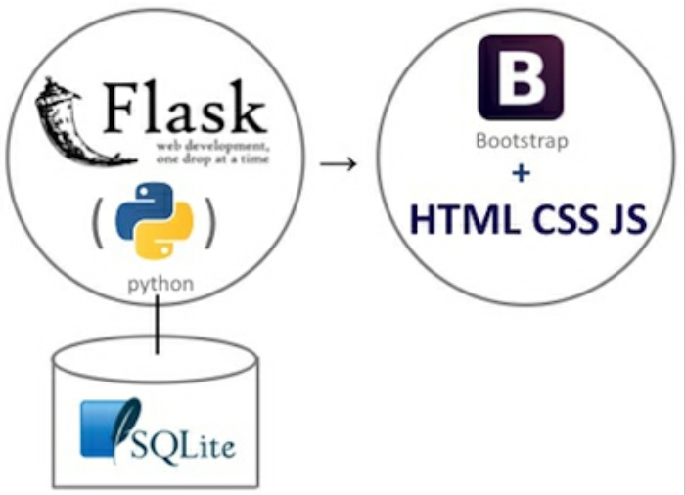
SYSTEM ARCHITECTURE/BLOCK DIAGRAM
Block diagram

Slide 8
IMPLEMENTATION
Pseudo code
Front Page:
from flask import Flask,render_template,request,redirect,url_for
import sqlite3 as sql
app=Flask(__name__)
@app.route('/')
def home():
return render_template('slide1.jinja2')

Slide 9
Database Connection :
try:
with sql.connect("sqldb.db") as con:
cur = con.cursor()
cur.execute("")
con.commit()
msg = "Record saved successfully"
except:
con.rollback()
msg = "Error in inserting record"
finally:
con.close()
return render_template("addroom.jinja2", msg=msg)

Slide 10
Libraries used / API’S
Flask
Telegram
Sqlite
Configuration
conversation = ConversationV1(username='7bb25d7a-3043-45c8-981d-6d00b1c5001d',
password='*********’',
version='2018-02-16')
response = conversation.message(workspace_id='f180669e-bd58-4574-b231-066894c7dd58',
input={'text': update.message.text},
context=context))

Slide 11
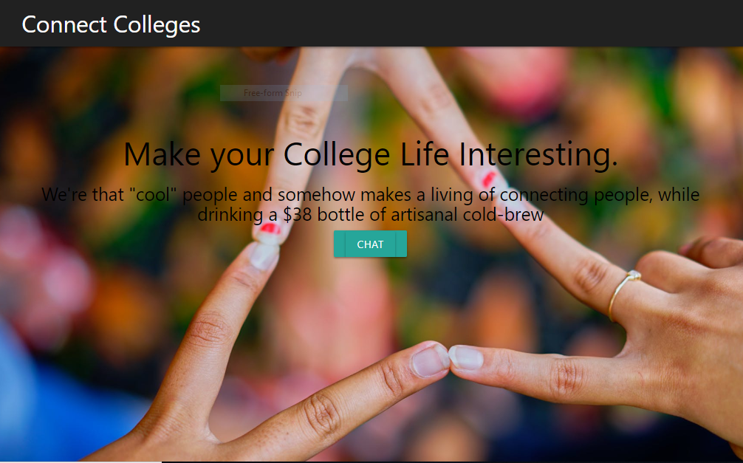
RESULT ANALYSIS
Snapshots

Slide 12
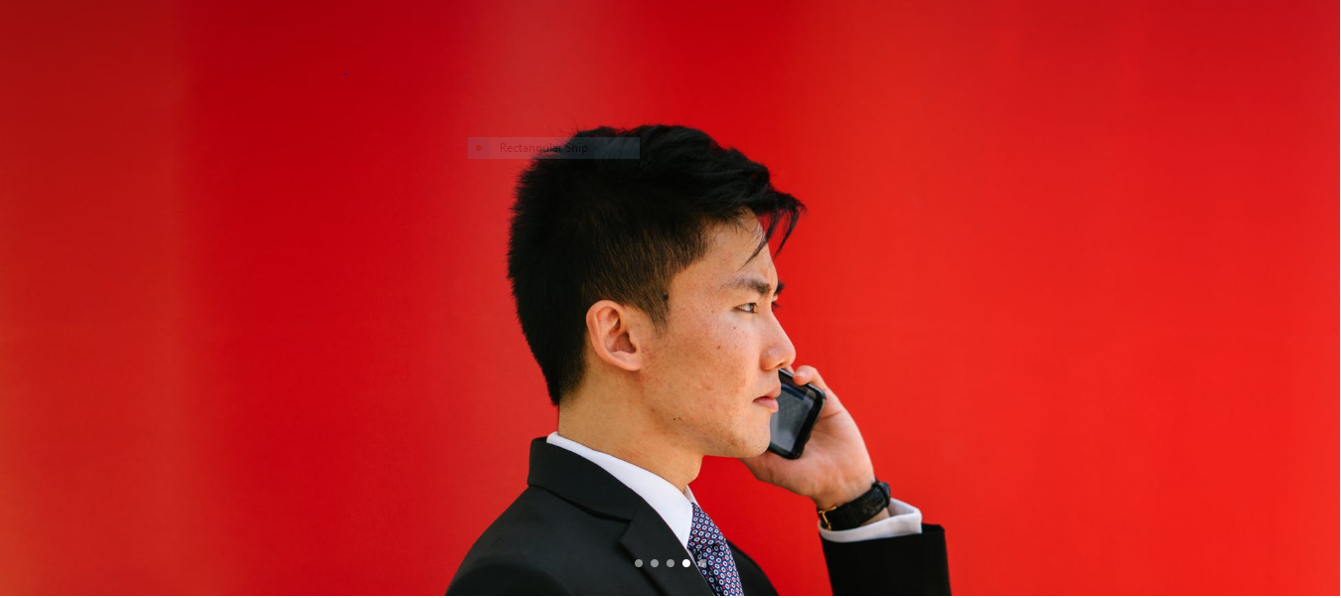
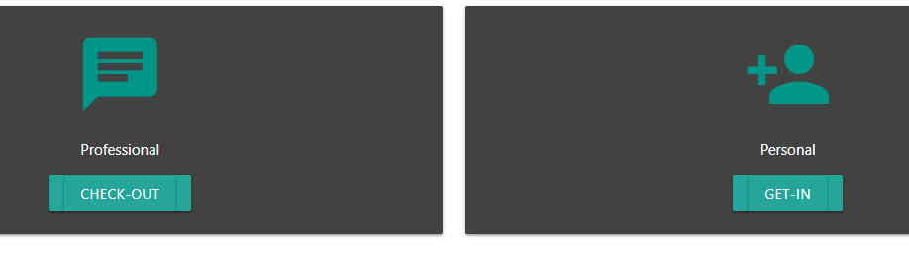

Slide 13
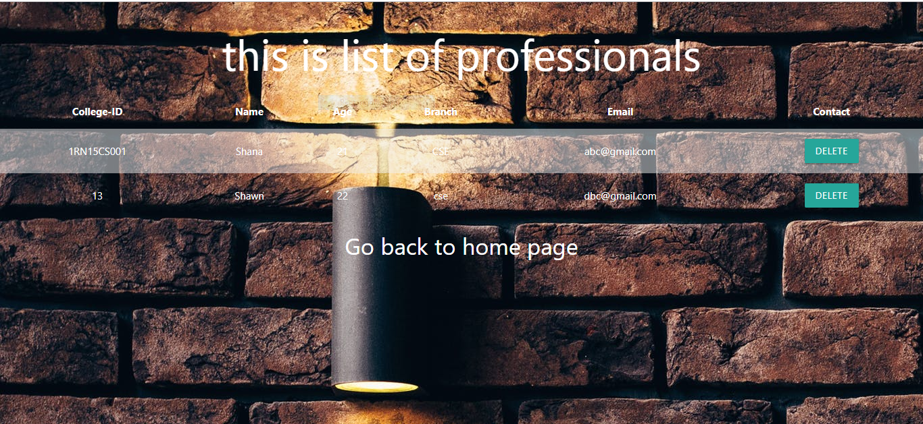

Slide 14
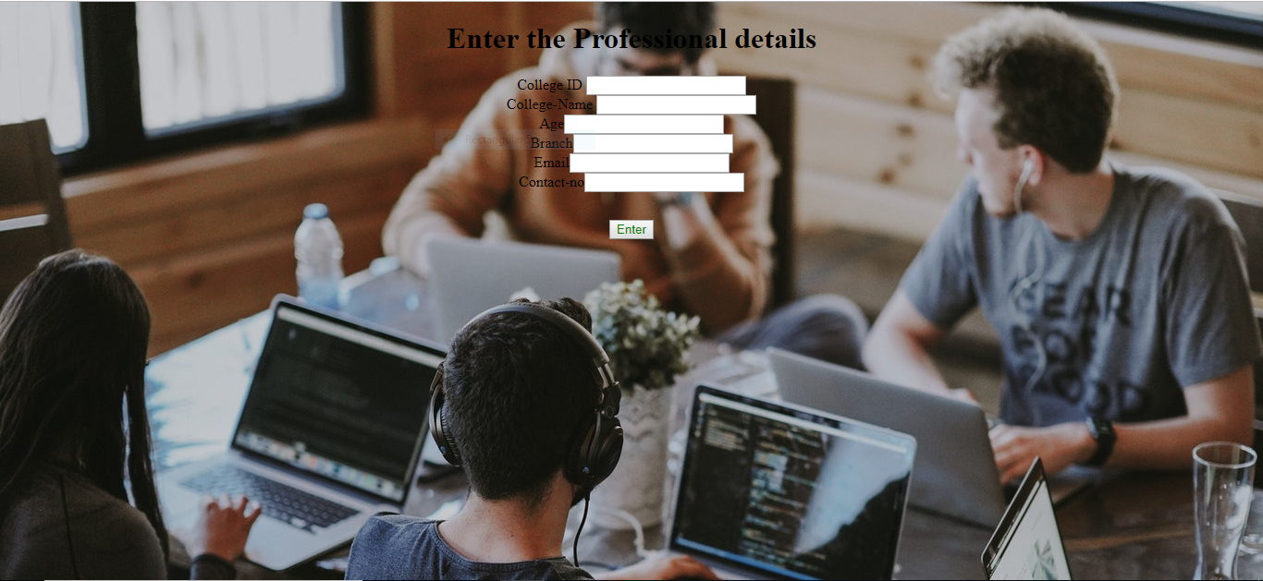

Slide 15
CONCLUSION AND FUTURE WORK
Conclusion
We were able to do few of the features like configuring watson and making the forms , parts of dbms and some of the web front end in the given time constraint.
Future work
We hope to finish the application and deploy it in AWS so that we are in business .

Slide 16
REFERENCES
[1] Wikipedia
https://en.wikipedia.org/wiki/flask https://en.wikipedia.org/wiki/SQLite
[2] W3Schools
https://www.w3schools.com/html/
https://www.w3schools.com/css/
https://www.w3schools.com/bootstrap/
https://www.w3schools.com/sql/
[3] Internshala Web Course
https://trainings.internshala.com/web-development

Slide 17
Thank You!!!

